Slide 1

IFTTT.com Overview & Design Analysis
Summer 2016
Caleb Lucas-Foley
Benjamin Zackin
Notes:
As inspiration for our new interface designs, we looked at IFTTT, a web service with a simple “if-this-then-that” model.

Slide 2
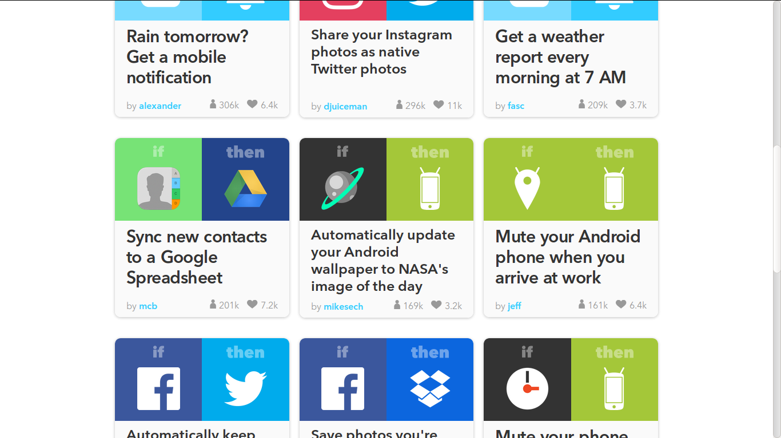
Overview of IFTTT.com
IFTTT.com is a website that lets its users link events to each other so that certain events “trigger” others to happen.
The events may belong to any of a large set of third party web services.
Notes:
IFTTT links together third party web services to automate certain tasks. For example, IFTTT can send you an email when your phone battery is low, or turn your smart lights on when your phone’s GPS location is your home.

Slide 3
Glossary of Jargon
Trigger - Event that triggers the action
ex.: it starts raining, a certain Wikipedia page is edited, a text message is received
Action - The event executed after the trigger
ex.: send a text message, post to twitter or facebook, change the color of my smart light bulbs
Channel - The service to which triggers and/or actions may belong
ex.: Slack, Yahoo Weather, Wikipedia
Recipe - The link between a trigger and action
ex.: text me when it starts raining, automatically add new photos to Google Drive
Ingredient - Extra data sent from the trigger channel which may modify the action, mostly for the purpose of giving informative messages and data
ex.: timestamps, relevant image links, current weather data
Notes:
IFTTT employs a cooking metaphor. “Recipes” link together a trigger and an action, each belonging to a “channel,” a distinct web service that has partnered with IFTTT. In addition to the trigger, some extra data, called “ingredients,”are sent to the action channel.

Slide 4
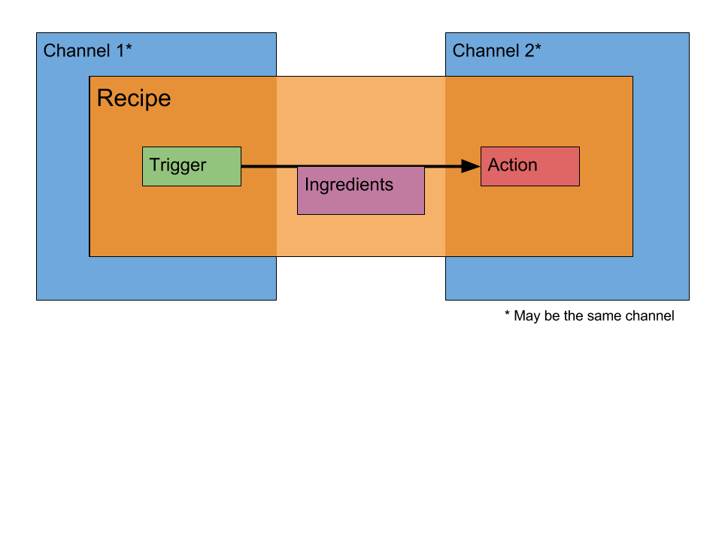
Notes:
Here is the structure of a recipe. Note that the trigger and action may belong to the same channel.

Slide 5
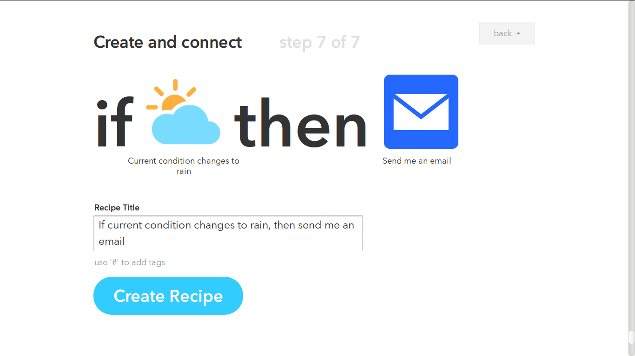
IF Recipes
When the trigger channel tells IFTTT.com that the trigger condition has been met, IFTTT tells the action channel to perform the specified action.
The website also has a category for “DO Recipes,” which are not very relevant to us
Notes:
All of the recipes are laid out in a simple “IF X THEN Y” structure. IFTTT itself serves as a middleman, polling the trigger channels at regular intervals. In this case, the Weather channel tells IFTTT that it’s raining, so IFTTT sends an email.

Slide 6
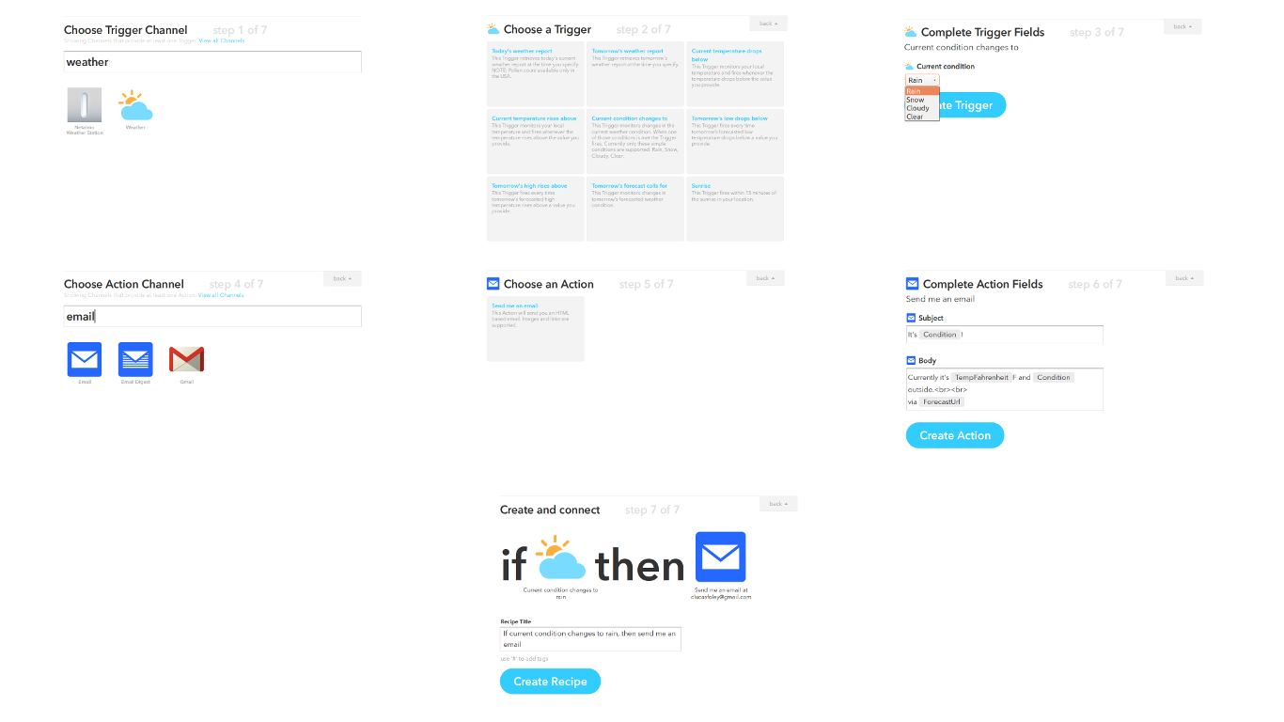
1
2
3
4
5
6
Seven-step process to create a recipe
IFTTT walks you through one step at a time, every time
Easy to follow the first time, but very time-consuming to make a lot of recipes
7
The screens are “scrolled” between–a decision clearly made with tablets in mind
Notes:
There are 7 steps to creating a recipe. The site walks you through the process whether it is your first time or not. Since the site design appears to be oriented towards tablet-users, each step occupies its own page with a half-second scrolling animation between screens. The next few slides will walk you through that process.

Slide 7
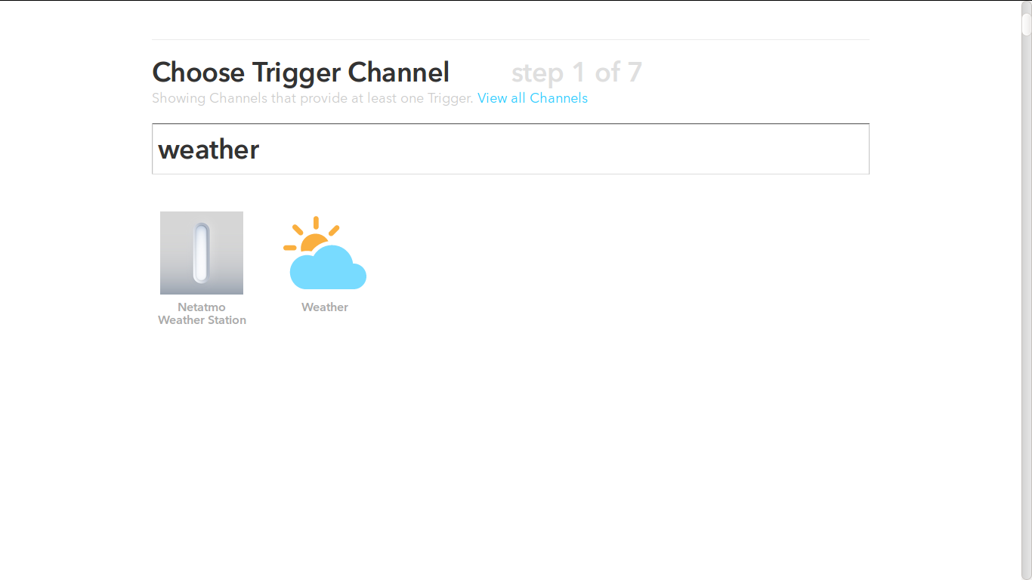
There’s no way to save frequently used channels or sort search results
There’s no way to see the list of triggers before selecting the channel
Notably, many channels require that you connect an account immediately after selecting them.
Notes:
The interface for selecting channels is very limited–you can only search by title, and you cannot save your favorite channels or search for triggers directly. Before using a channel, you often have to connect it to an existing third-party account. You only ever have to do this once, since the system keeps track of all of your connected accounts.

Slide 8
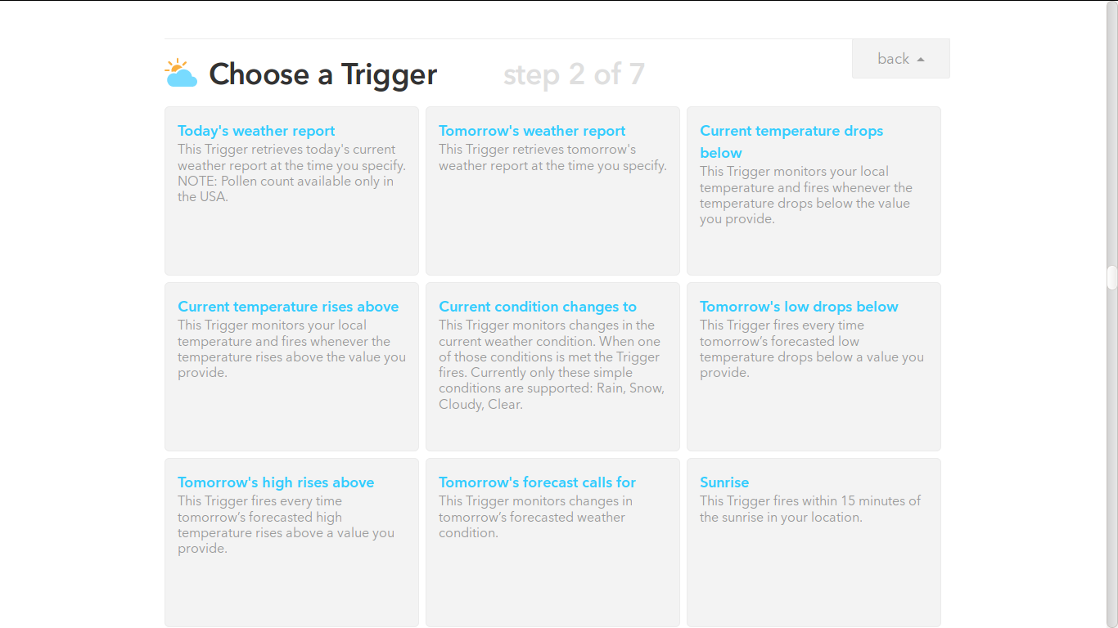
Some channels have more triggers available than others.
This choice determines which “ingredients” will be available to the action process later
Notes:
The triggers are listed in a grid layout. The weather channel has 11 or 12 triggers available, all of which activate at different times and under different sorts of conditions. Timing, however, is not very precise, since IFTTT only polls the weather service about every 15 minutes.

Slide 9
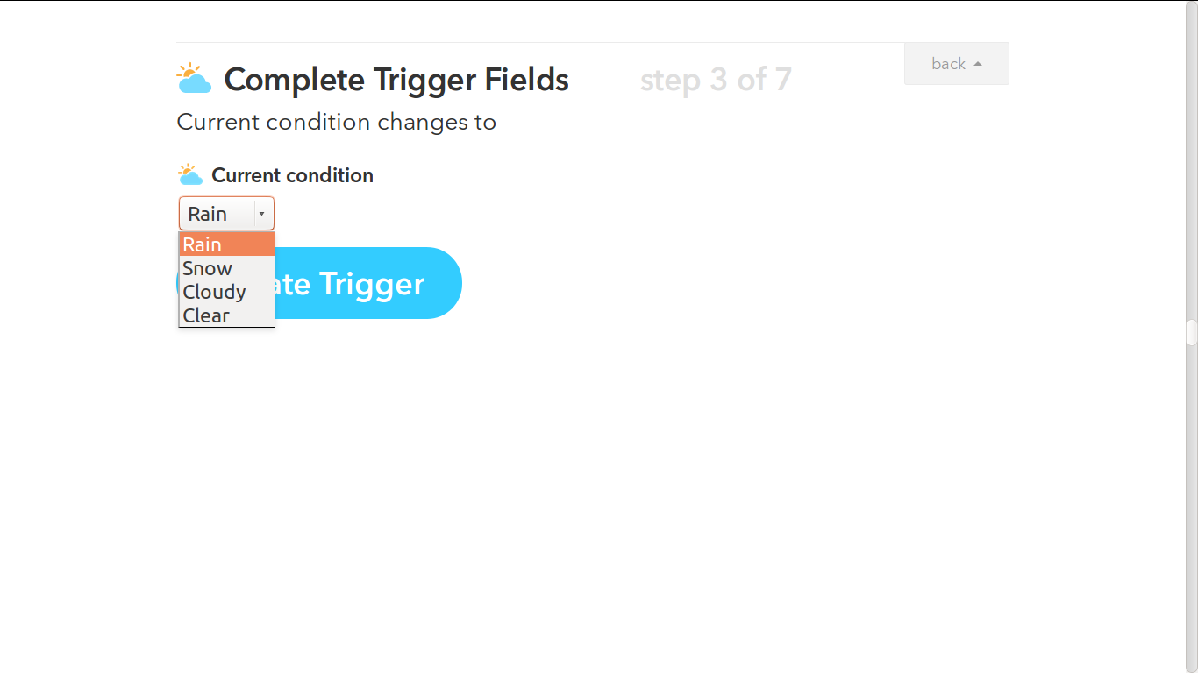
This screen varies from service to service.
Notes:
Some triggers offer more options, such as a specific temperature or price threshold to watch for. However, there’s no way to include more detail than what is explicitly listed.

Slide 10
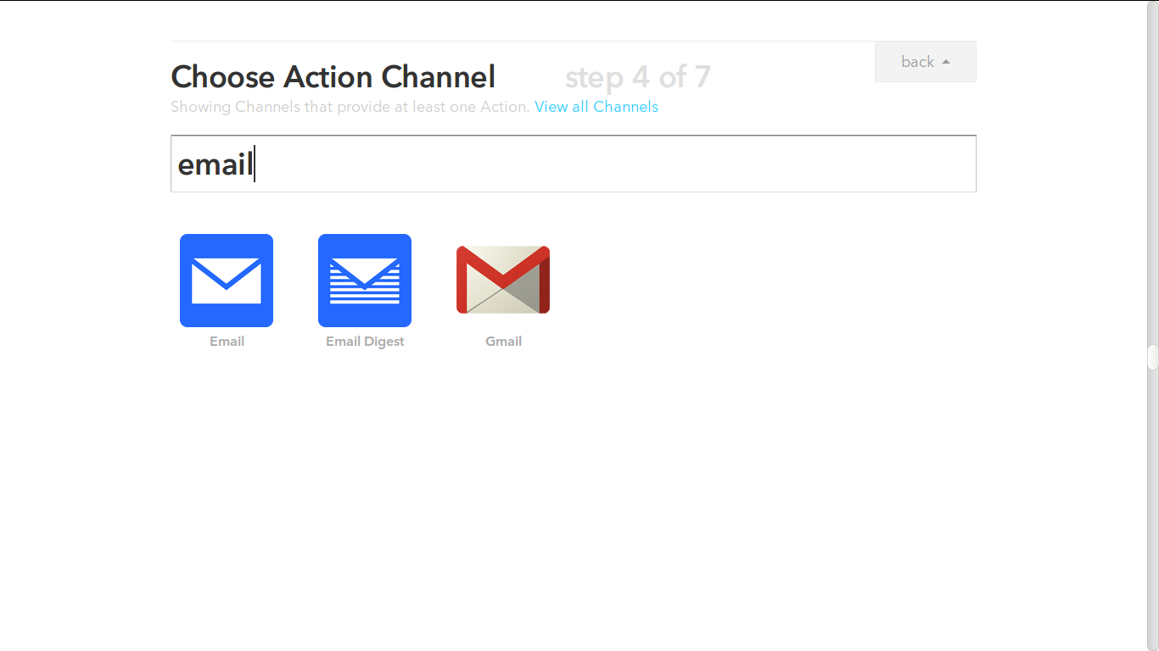
Once again, the search is really awful.
Note that some channels only have triggers or only have actions; they just don’t show up in the search.
There are distinctions that are not obvious from this screen.
Example: “Email” and “Email Digest” can send messages, and don’t require a linked account. “Gmail” deals with a user’s inbox, which must be linked.
Notes:
The differences between channels are not immediately obvious from the search screen. In this case, “Email” is an interface for sending and receiving emails to and from IFTTT, while Gmail interacts with an inbox which must be connected to a user’s account. There’s no way to tell the difference between these channels until you select one.

Slide 11
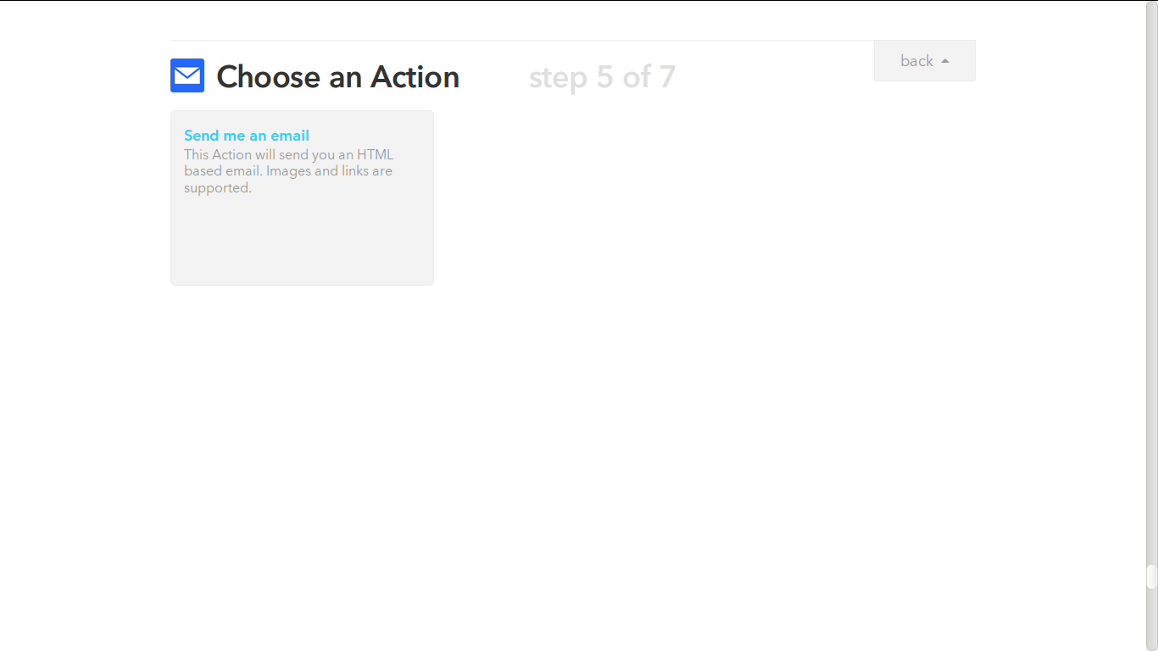
This process can get very tedious
Notes:
There is a lot of variation in the number of triggers and actions available to each channel. Some channels don’t even have triggers, or don’t have any actions.

Slide 12
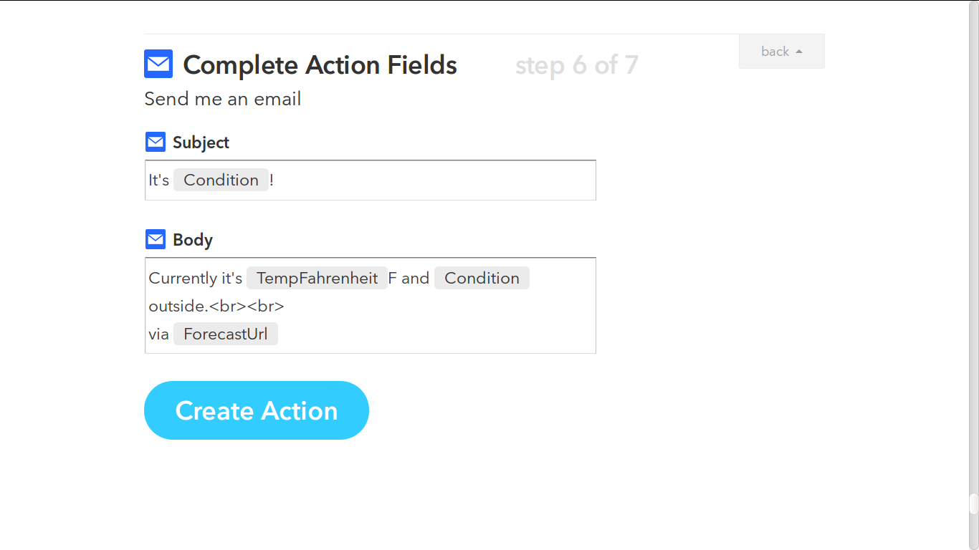
Certain “ingredients” (determined by the trigger) can be plugged into any of the action’s fields.
This lets you do things like embed an image specified by an action, or mention specific usernames by name.
There is a drop-down interface to select the ingredients.
Notes:
This is where the ingredients come into play. They serve no purpose in most recipes besides customizing messages. For example, triggers from the weather channel offer thumbnail images indicating the current weather conditions.

Slide 13
Recipes are titled. Notably, this title is the only indicator of the specific trigger and action used, since the icons only indicate the channels.
Notes:
Most of the time, recipes are displayed as the two channel icons with the title underneath. The title is the only indicator of what the purpose of the recipe is, so it’s important to write a good one.

Slide 14
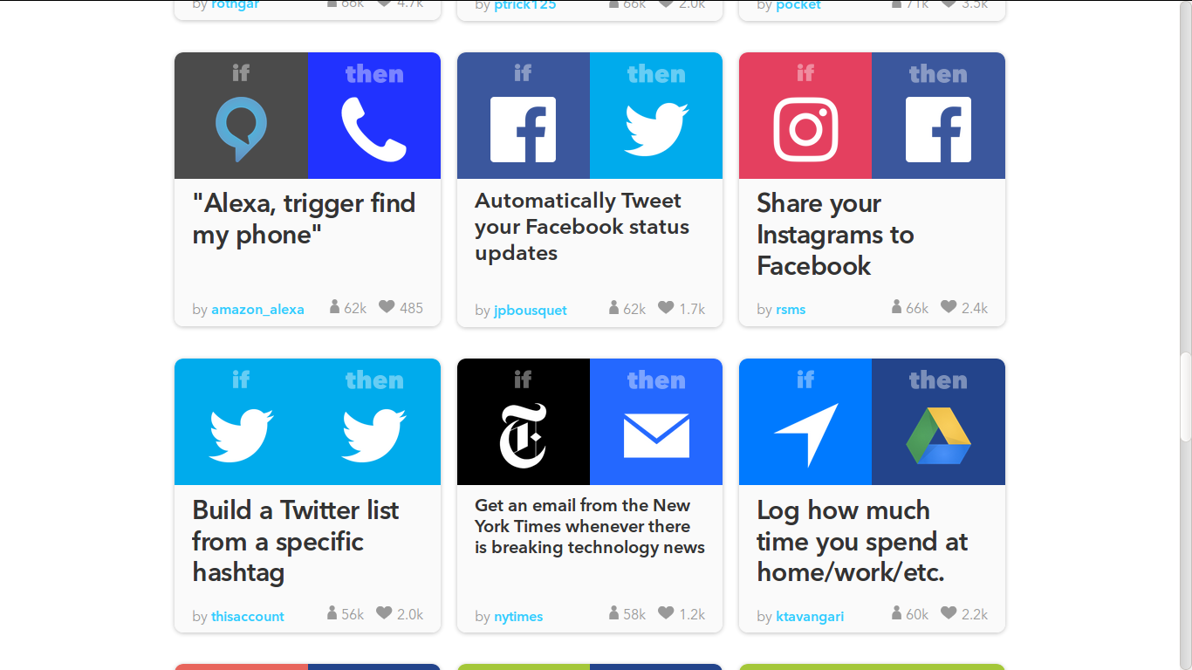
Recipe Browser
The IFTTT.com home page is a list of recipes shared by other users. These can be selected and added
IFTTT uses this to build a community on their site, especially since using someone else’s recipe is so much quicker than making one yourself.
Some of the shared recipes are advertisements
Notes:
IFTTT is trying to build a community through their public recipe browser. Most of the popular recipes are made by users, but some are sneaky advertisements for the partner services.

Slide 15
Imagery
Big colorful buttons
Great for touch screens and also looks simple
The imagery is not very informative. All the icons refer to the channels, not the specific triggers or actions.
This probably looks better to partner companies than users (Their logos are front and center!)
Notes:
The site’s imagery is simple and colorful – this makes it approachable, but at the cost of some informativity.

Slide 16
Inspiration to take from IFTTT.com
Large colorful interface is good.
Little fiddly bits are intimidating
Concurrency is required.
Need triggers from multiple sources to be available at the same time.
The channels on IFTTT.com are analogous to the Mindstorms sensors/motors
Clear distinction made between the triggers and the actions.
Tutorial mode that walks you through the process of setting up a simple trigger-action pair.
Notes:
Here are some of the lessons we took away from IFTTT: A simple, approachable interface is good to have. We also want to be able to run many different “recipes” at the same time. Triggers and actions, while both events, should be treated differently. And a comprehensive tutorial would be a good idea, as long as you can turn it off eventually.

Slide 17
Warnings/Pitfalls - Things that worked for IFTTT but probably won’t for us
Avoid non-descriptive imagery
We will probably want descriptive icons that say what the “recipes” do at a glance
A sequential recipe-building interface is overly limiting and tedious
Being able to select the trigger and action at the same time would be better
IFTTT polls some channels as infrequently as every 15 minutes
This causes long delays; we’ll want to keep server load in mind
Only one action per trigger isn’t enough
We will probably want to link sequences of actions to single triggers, too
Notes:
On the other hand, IFTTT does a lot of things that won’t work for us. It would be better to have descriptive icons for each component rather than relying on titles. We’ll also want to be able to select triggers and actions at the same time instead of in sequence. We can try to avoid IFTTT’s long polling periods by being smart about network traffic. We also probably want to be able to link entire control flow sequences to single triggers.

Slide 18
Warnings/Pitfalls - Things that worked for IFTTT but probably won’t for us (continued)
IFTTT has no support for more complicated logic or math.
We want AND and OR for compound triggers
We’ll want to support more math, support variables, etc.
Don’t design for tablets.
Forcing a tablet interface onto traditional computers is a bad idea
We need a good navigable menu system. Search doesn’t cut it.
Maybe there should be some way to see the functionality of a component before adding it
Notes:
IFTTT isn’t very flexible since there is no way to make more complex triggers. Users cannot make compound triggers using multiple services at a time, or to do mathematical operations to set dynamic trigger conditions. The tablet-centric design isn’t something we want to emulate either. We also need a good menu system instead of relying on a search bar, and we’ll want to enable our users to make informed choices of which components to add, through tutorials and documentation.

Slide 19
End of Presentation
Notes:
Thank you, I hope this is useful.

